Slide 1
Welcome to the experiment, and thank you for agreeing to take part in this study.
This task examines your visual search performance. On each trial you will see a collection of L shapes, with a single T positioned somewhere among them. Your task is to search for this “target letter” ‘T’.
Once you have found the ‘T’, you need to respond to the direction in which it is rotated, either left or right.
If the T is rotated to the left, press the C key
If the T is rotated to the right, press the N key
Press the space bar for more instructions

Slide 2
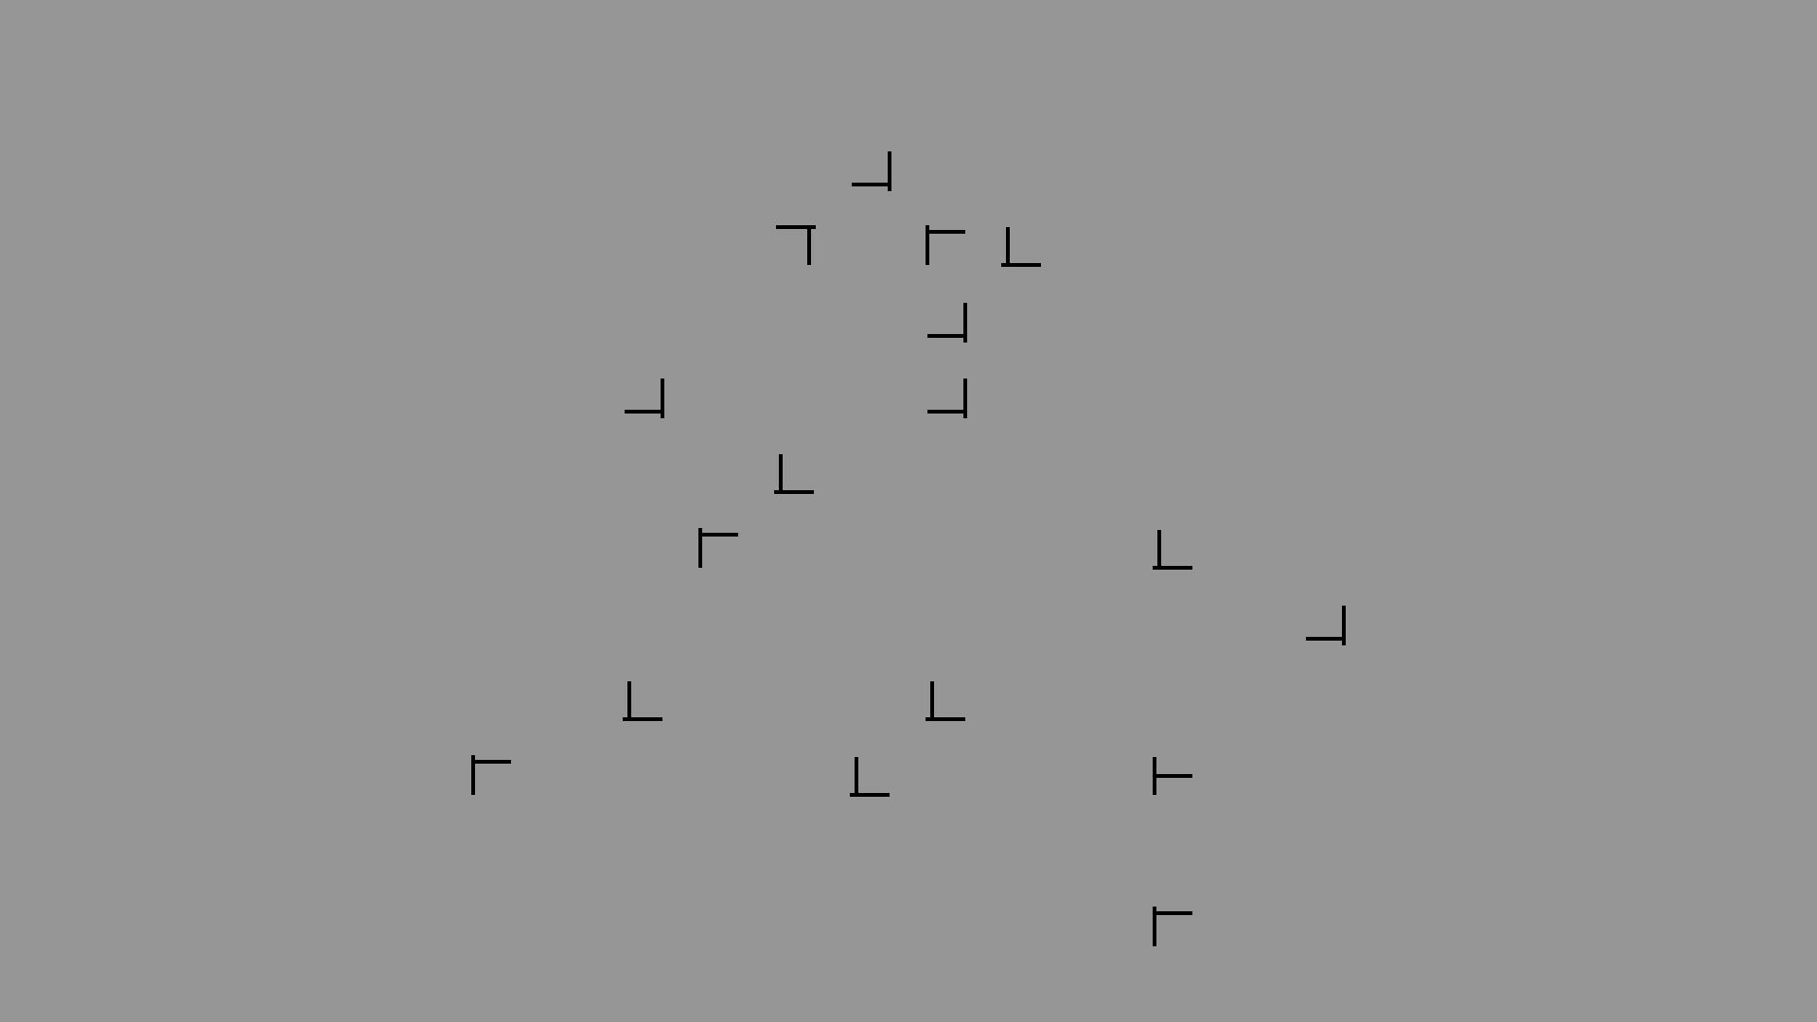
This is an example display. The target is rotated to the left, so here you would press the C key.
Press the space bar for more instructions

Slide 3
On half of the trials, an arrow will appear before the start of each trial. This arrow will tell you on which side of the screen the target will appear. The arrow is always accurate: the target will always appear on the side which the arrow is pointing towards.
If you respond with the correct key, the task will continue to the next trial.
However, if you respond with the wrong key, an error message will be displayed for 3 seconds. Please try to avoid making errors in this task.
You will be given regular short rest-breaks during the task.
Please ask the experimenter if you have any questions
When you are ready to start, place your index fingers on the C and N keys. The experimenter will then start the task.

Slide 4
In the next phase of the task, the arrow will no longer appear before the start of each trial.
Your task in this phase is identical to the previous phase: locate the target and respond to the rotation of the T (rotated to the left or to the right) using the C and N keys.
When you are ready to resume, place your index fingers on C and N and inform the experimenter.

Slide 5
You have now finished the main task. In the next phase we would like to test your memory for what you have experienced.
You may or may not have noticed that some of the patterns you experienced in the previous phase repeated across the experiment many times.
Do not worry if you did not notice this – many people fail to notice that these patterns are repeating.
Press the space bar for more instructions

Slide 6
In this next phase we would like to test your memory for these patterns. For each pattern, please indicate whether you believe it is an old pattern that you have seen before in the experiment, or is a new one (that you did not see in the previous phase of the experiment).
You will view the pattern for 5 seconds, after which you need to respond UP or DOWN.
Press the ‘UP’ key if you think the pattern is OLD
Press the ‘DOWN’ key if you think the pattern is NEW
When you are ready to resume, place your fingers on UP and DOWN and inform the experimenter.

Slide 7
OLD or NEW?
Did you see that pattern in the previous task?
If you think it was OLD, press UP
If you think it was NEW, press DOWN

Slide 8
The experiment is complete!
Thank you for taking part in this experiment. The aim of this study is to examine how the arrangement of distractor objects affects the speed at which you can locate a target, and whether you are aware of repeated configurations.
Your data will remain confidential throughout, and will be stored anonymously at all times and cannot be traced back to you. Please note that due to the anonymous nature of the data storage, we are unable to delete individual data in the future.
If you are interested to hear more about this research, please contact the lead investigator Dr Tom Beesley (t.beesley@lancaster.ac.uk)
Thank you once again. Please see the experimenter.

Slide 9
INCORRECT RESPONSE

Slide 10
TIMEOUT – TOO SLOW

Slide 11
Rest break
Trials will start automatically in 30 seconds

